Slide 1
Home security using Using face recognition
Under the guidance of
Dr.nanda kumar.M
Done by-
G.Sharan(17311A19F1)
V.Sai Madhav(17311A19H0)
G.Shripadh Rao(17311A19H6)

Slide 2
Introduction
Face recognition is the task of identifying an already detected object as a known or unknown face. Often the problem of face recognition is confused with the problem of face detection Face Recognition on the other hand is to decide if the “face” is someone known, or unknown, using for this purpose a database of faces in order to validate this input face.

Slide 3
What is dlib?
It‘s a landmark’s facial detector with pre-trained models, the dlib is used to estimate the location of 68 coordinates (x, y) that map the facial points on a person’s face like image below.Since development began in 2002, Dlib has grown to include a wide variety of tools. As of 2016, it contains software components for dealing with networking, threads, graphical user interfaces, data structures, linear algebra, machine learning, image processing, data mining, XML and text parsing, numerical optimization, Bayesian networks, and many other tasks.In recent years, much of the development has been focused on creating a broad set of statistical machine learning tools and in 2009 Dlib was published in the Journal of Machine Learning Research.Since then it has been used in a wide range of domains.
Installing the dependencies-
pip install numpy opencv-python dlib imutils

Slide 4
FACE DETECTION:
Face detection involves separating image windows into two classes; one containing faces (tarning the background (clutter). It is difficult because although commonalities exist between faces, they can vary considerably in terms of age, skin colour and facial expression. The problem is further complicated by differing lighting conditions, image qualities and geometries, as well as the possibility of partial occlusion and disguise. An ideal face detector would therefore be able to detect the presence of any face under any set of lighting conditions, upon any background. The face detection task can be broken down into two steps.
The first step is a classification task that takes some arbitrary image as input and outputs a binary value of yes or no, indicating whether there are any faces present in the image. The second step is the face localization task that aims to take an image as input and output the location of any face or faces within that image as some bounding box with (x, y, width, height).

Slide 5
The face detection system can be divided into the following steps :-
1. Pre-Processing: To reduce the variability in the faces, the images are processed before they are fed into the network. All positive examples that is the face images are obtained by cropping images with frontal faces to include only the front view. All the cropped images are then corrected for lighting through standard algorithms.
2. Classification: Neural networks are implemented to classify the images as faces or nonfaces by training on these examples. We use both our implementation of the neural network provided by the dlib for this task. Different network configurations are experimented with to optimize the results.
3.Localization: The trained neural network is then used to search for faces in an image and if present localize them in a bounding box. Various Feature of Face on which the work has done on:- Position Scale Orientation Illuminati

Slide 6
Deep learning:
Deep Learning is nothing but a standard paradigm of Machine learning, or more precisely — one of its algorithms. For the greatest extent, it is based on a concept of a human brain and the interaction of neurons. If you start googling what Deep learning is, you will notice this super hot word today is far away from being new. Why so? The term itself appeared in the 1980s, but until 2012, there was not enough power to carry out this technology and almost no one paid attention to it.
What happened in 2012? A team led by Dahl won the Merck Molecular Activity Challenge using multi-task deep neural networks to predict the bio-molecular target of one drug. And voila, this caused a significant boom in the mass media scene and so lots of other researchers and developers started to work with it too.

Slide 7
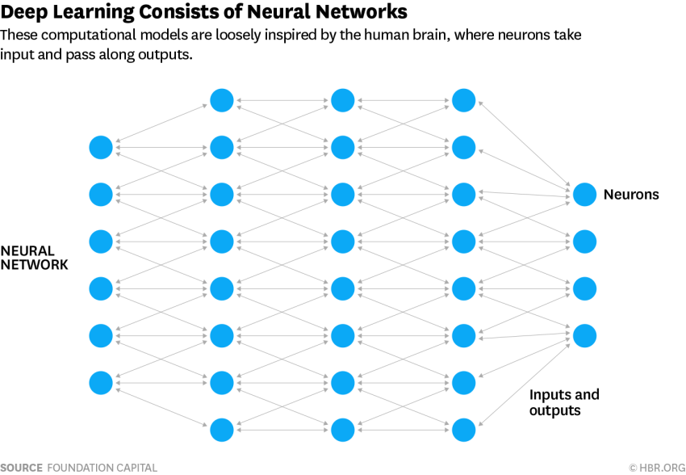
How does deep learning work?
Deep learning systems are modeled after the neural networks in the neocortex of the human brain, where higher-level cognition occurs. In the brain, a neuron is a cell that transmits electrical or chemical information. When connected with other neurons, it forms a neural network. In machines, the neurons are virtual — basically bits of code running statistical regressions. String enough of these virtual neurons together and you get a virtual neural network.
To understand deep learning, imagine a toddler whose first word is a dog. The toddler learns what a dog is (and is not) by pointing to objects and saying the word dog. The parent says, “Yes, that is a dog,” or, “No, that is not a dog.” As the toddler continues to point to objects, he becomes more aware of the features that all dogs possess. What the toddler does, without knowing it, is clarify a complex abstraction (the concept of dog) by building a hierarchy in which each level of abstraction is created with the knowledge that was gained from the preceding layer of the hierarchy

Slide 8
Neural network-
Neural networks gaining much more attention in many pattern recognition problems, such as OCR, object recognition, and autonomous robot driving. Since face detection can be treated as a two class pattern recognition problem, various neural network algorithms have been proposed.
The advantage of using neural networks for face detection is:
The feasibility of training a system to capture the complex class conditional density of face patterns. However, one demerit is that the network architecture has to be extensively tuned (number of layers, number of nodes, learning rates, etc.) to get exceptional performance.In early days most hierarchical neural network was proposed by Agui et al. The first stage having two parallel subnetworks in which the inputs are filtered intensity values from an original image. The inputs to the second stage network consist of the outputs from the sub networks and extracted feature values. An output at the second stage shows the presence of a face in the input region. Propp and Samal developed one of the earliest neural networks for face detection. Their network consists of four layers with 1,024 input units, 256 units in the first hidden layer, eight units in the second hidden layer, and two output units. Feraud and Bernier presented a detection method using auto associative neural networks. The idea is based on which shows an auto associative network with five layers is able to perform a nonlinear principal component analysis. One auto associative network is used to detect frontal- view faces and another one is used to detect faces turned up to 60 degrees to the left and right of the frontal view. After that Lin et al. presented a face detection system using probabilistic decision-based neural network (PDBNN). The architecture of PDBNN is similar to a radial basis function (RBF) network with modified learning rules and probabilistic interpretation.

Slide 9
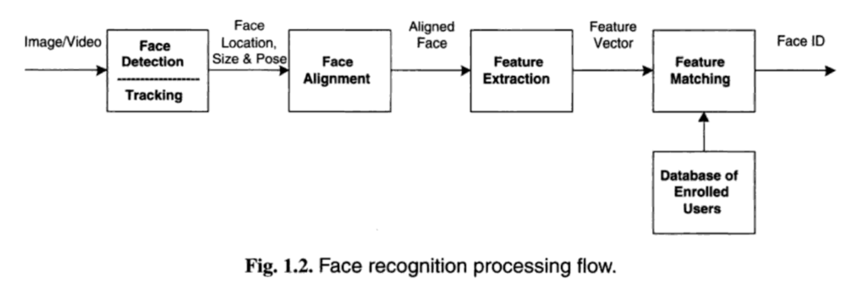
Key Steps to Detect a Face from a Photo-
1. First, you need to look at the image and find all the faces on it.
2. Secondly, it is necessary to focus on each face and determine that, despite the unnatural turn of the face or poor lighting, it is the same person.
3. Thirdly, it is necessary to highlight the unique characteristics of the face, which can be used to distinguish it from other people — for example, the size of the eyes, the elongation of the face, etc.
4. In conclusion, it is necessary to compare these unique characteristics of the face with the characteristics of other people you know to determine the name of the person.

Slide 10
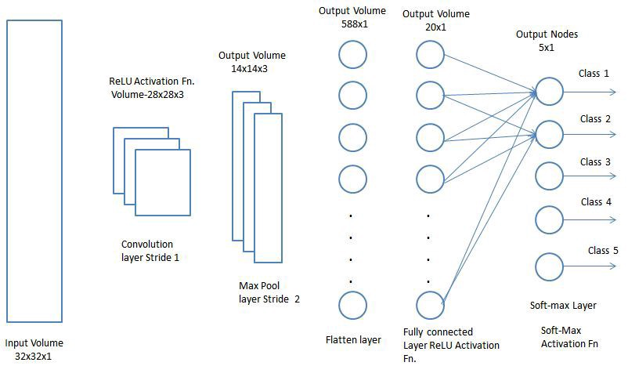

Slide 11
Components used-
-NodeMCU(ESP8266)
-Servo motor

Slide 12
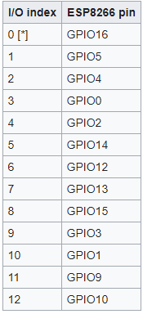
Node mcu:
NodeMCU is an open source IoT platform. It includes firmware which runs on the ESP8266 Wi-Fi SoC from Espressif Systems, and hardware which is based on the ESP-12 module.
NodeMCU provides access to the GPIO(General Purpose Input/Output) and a pin mapping table is part of the API documentation.

Slide 13
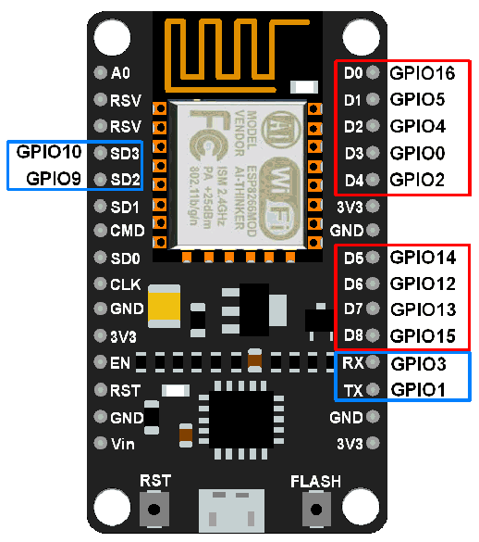
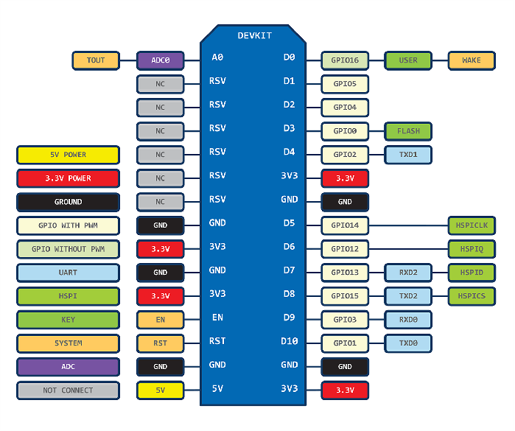

Slide 14
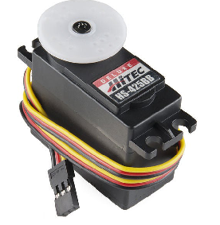
Servo motor
Servo motors are great devices that can turn to a specified position . Usually, they have a servo arm that can turn 180 degrees.
Servo motors were first used in the Remote Control (RC) world, usually to control the steering of RC cars or the flaps on a RC plane. With time, they found their uses in robotics, automation, and of course, the Arduino world.

Slide 15
Softwares used-
-PYTHON 3.7.4
-ARDUINO IDE 1.8.9
-THINGSPEAK (mathworks)

Slide 16
Libraries used-
LIBRARIES IN PYTHON :
-Face_Recognition (Deep learning package in C++)
-OpenCV
-Numpy
-Urllib

Slide 17
Face_recognition -
-OpenCV uses machine learning algorithms to search for faces within a picture. Because faces are so complicated, there isn’t one simple test that will tell you if it found a face or not. Instead, there are thousands of small patterns and features that must be matched. The algorithms break the task of identifying the face into thousands of smaller, bite-sized tasks, each of which is easy to solve. These tasks are also called classifiers.
-For a face, you might have 6,000 or more classifiers, all of which must match for a face to be detected (within error limits, of course).
-Recognize and manipulate faces from Python or from the command line with the world’s simplest face recognition library.
-Built using dlib’s state-of-the-art face recognition built with deep learning. The model has an accuracy of 99.38% on the Labeled Faces in the Wild benchmark

Slide 18
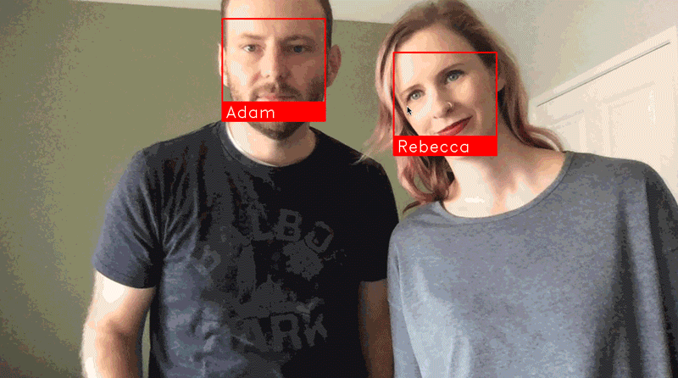
Face recognition example -

Slide 19
Opencv -
-OpenCV was started at Intel in 1999 by Gary Bradsky and the first release came out in 2000.
-OpenCV (Open Source Computer Vision Library: http://opencv.org) is an open-source BSD-licensed library that includes several hundreds of computer vision algorithms. The document describes the so-called OpenCV 2.x API, which is essentially a C++ API, as opposed to the C-based OpenCV 1.x API (C API is deprecated and not tested with "C" compiler since OpenCV 2.4 releases)
-OpenCV supports a lot of algorithms related to Computer Vision and Machine Learning and it is expanding day-by-day.
-OpenCV supports a wide variety of programming languages like C++, Python, Java etc and is available on different platforms including Windows, Linux, OS X, Android, iOS etc.
-OpenCV-Python is the Python API of OpenCV. It combines the best qualities of OpenCV C++ API and Python language.

Slide 20
Numpy -
NumPy is a Python package which stands for ‘Numerical Python’. It is the core library for scientific computing, which contains a powerful n-dimensional array object, provide tools for integrating C, C++ etc.
It is also useful in linear algebra, random number capability etc. NumPy array can also be used as an efficient multi-dimensional container for generic data.
NumPy Array: Numpy array is a powerful N-dimensional array object which is in the form of rows and columns. We can initialize numpy arrays from nested Python lists and access it elements.
We use python numpy array instead of a list because of the below three reasons:
Less Memory
Fast
Convenient

Slide 21
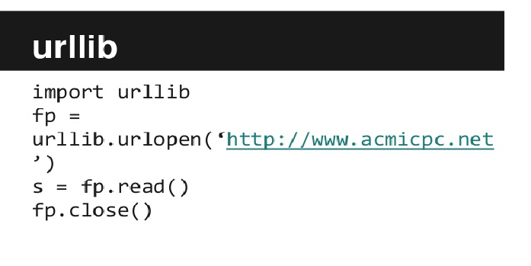
Urllib -
-URLLIB is a Python module that can be used for opening URLs. It defines functions and classes to help in URL actions.
-With Python you can also access and retrieve data from the internet like XML, HTML, JSON, etc. You can also use Python to work with this data directly.

Slide 22


PSEUDO CODE-
Automatically find all the faces in an image:
Finding faces using cnn(optional):

Slide 23
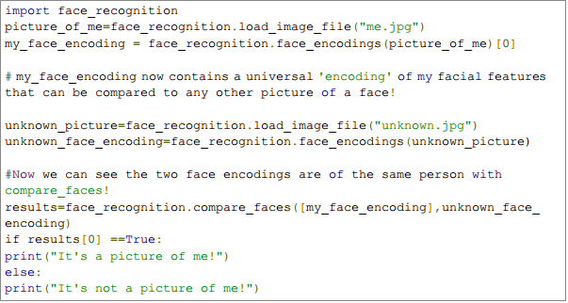
Recognize faces in images and identify who they are:

Slide 24
Advantages -
Increased Security:
One of the biggest pros of facial recognition technology is that it enhances safety and security. From government agencies to personal use, there is an increasing demand for advanced security and surveillance systems.
Fast and Accurate: With the ever-increasing demand for speed and the growing number of cyberattacks, having fast and accurate technology is key.

Slide 25
Disadvantages -
Data Storage: The video and high-quality images required for facial recognition take up a significant amount of storage.
Changes in Appearance and Camera Angle: Any major changes in
appearance, including facial hair and weight changes, can throw
off the technology

Slide 26
Future of face recognition-
Today, one of the fields that use facial recognition the most is security.Facial recognition is very effective tools that can help law enforcers recognize criminals and software companies are leveraging the technology to help users access their technology. This technology can be further developed to be used in other avenues such as ATMs,accessing confidential files, or other sensitive materials. This can make other security measures such as passwords and keys obsolete.

